Slide 1
Quick Wins - Final Report
November 21st, 2003
Jill Goodridge (IBM)

Slide 2
The purpose of the Quick Wins stream was to develop and implement strategies to deliver short term benefits to supplement substantial long term benefits to be realized from the RMS solution
Benefits include both process improvements and a targeted $1.5M impact to the organization by end of 2004
Quick Wins Team:
  William Liu (lead)
  Doreen MacKinnon
  Brian Sauve
  Jill Goodridge (IBM)

Slide 3
The scope includes seven Quick Win Projects that address issues identified in Casper Phase I and other Katz business issues
Issues
Substantial discontinued inventory in stores ($5.1M or 3% of total inventory)
Greeting cards among the slowest turning categories (<2)
No current process to reconcile McKesson invoices and therefore possible overcharges
Significant data integrity issues in FMS item master file (description, cost, retail etc)
Inefficient, individual databases used to manage item information
Old pricing methods do not address current business needs
No pricebooks in stores today
Quick Win Projects
#1: Develop and implement a strategy to Reduce Discontinued Inventory in stores
#2: Develop and implement a strategy to Improve DSD Inventory Turns (Cards)
#3: Determine Accuracy of McKesson Invoices
#4: Develop and implement a program to Cleanup FMS item master file
#5: Develop and implement FMS Lookup tool to efficiently manage item information
#6: Implement three new Pricing Methods
#7 Develop and implement Electronic Price Books
Anticipated Benefits
$
$
$
P
P
P
P
$ = Cash
P = Process
Notes:
#1: Develop and implement a strategy to Reduce Discontinued Inventory in stores
Currently $5.1M in discontinued inventory or 3% of total inventory
#2: Develop and implement a strategy to Improve DSD Inventory Turns
Greeting cards and cosmetics are slowest turning categories (<2)
#3: Identify any variances, if they exist, between McKesson invoices versus Katz costs in FMS, in order to Increase Accuracy of McKesson Invoices
Invoice errors, if any, are undetected because invoices are not reconciled
#4: Develop and implement a program to Cleanup FMS item master file
Many known errors in FMS.
#5: Develop and implement FMS Lookup to allow staff to search for, view and change item, cost and retail info in FMS
Manual, time consuming process
#6: Implement Pricing Methods …….
Bla bla
#7 Develop and implement Electronic Price Books
No pricebooks in stores today
Note: ECCNET scope was transferred to implementation stream

Slide 4
Quick Win #1
Reduce Discontinued Inventory

Slide 5
Four alternative strategies to reduce discontinued inventory were considered
Strategy | Actions & Findings | Conclusion
1: Return to Vendor | Cosmetics is the largest category of discontinued inventory (40%) and can be returned to the vendor, however, an initiative was already underway to reline the entire category Other categories are under strict return conditions imposed by McKesson Inventory visibility is required to negotiate a return to vendor | High Difficulty Low likelihood for success
2: Sell to Third Party | Inventory visibility is required to determine a quantity for sale Costly lessons from other retailers who do this i.e. Zellers | High Difficulty Low likelihood for success
3: Prevent Reordering | Not a problem for Katz: a red-sticker system helps stores identify discontinued inventory so that it is not re-ordered. However, stores may re-order discontinued inventory if it is requested from a customer | No significant opportunity
Notes:
Our initial focus was on cosmetics because it could be returned to the vendor after 60 days and it was the largest category of discontinued inventory. We soon discovered that an initiative was already underway to reline the entire cosmetics category
A third party company was hired identify all cosmetics inventory not on the planogram and return it to the vendor. P&G did it’s own reline. The initiative was completed by Aug 2003
QWT calculated that the reline had been successful in reducing discontinued inventory by approximately $1500 per PPD store. Therefore, we shifted our focus to other categories.
The next largest category, OTC, presented two key challenges. 1) Limitations to McKesson’s Returns Policy 2) A lack a tools to determine an inventory position needed to negotiate a return with the vendor. Therefore, strategies to return this inventory were not pursued further
QWT took a different approach to solve this problem and investigated two new hypotheses 1) Discontinued inventory is high because there are no mechanisms to prevent it from being reordered 2) Discontinued inventory is high because it is not moving out of the stores
The first hypothesis was rejected. A red-sticker system helps stores identify discontinued inventory so it is not re-ordered.
The second hypothesis is true. 65% of the discontinued inventory is greater than 3 months old and 20% is greater than 12 months old, despite the fact that discontinued items are mark-downed at least twice

Slide 6
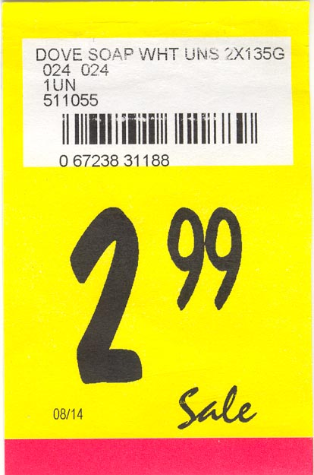
The most viable opportunity to reduce inventory was to stimulate sales by bringing visibility to discontinued inventory in the stores
Strategy | Actions & Findings | Conclusion
4: Stimulate Sales | Today there is no in-store visibility given to discontinued items (see A) unlike promotions which are flagged with a bright yellow sticker sign (see B). Therefore a customer looking for a deal would be more attracted to a promotion than something that has been marked down to clear Competitors such as Shoppers use clearance signage to help customers identify discontinued items By introducing signage to discontinued inventory (see C), the estimated reduction in inventory is $1M in 1 year | Low Difficulty High likelihood for success
A
B
LEGEND
A = Current Promo Label
B = Current Discontinued Red Label
Notes:
Our initial focus was on cosmetics because it could be returned to the vendor after 60 days and it was the largest category of discontinued inventory. We soon discovered that an initiative was already underway to reline the entire cosmetics category
A third party company was hired identify all cosmetics inventory not on the planogram and return it to the vendor. P&G did it’s own reline. The initiative was completed by Aug 2003
QWT calculated that the reline had been successful in reducing discontinued inventory by approximately $1500 per PPD store. Therefore, we shifted our focus to other categories.
The next largest category, OTC, presented two key challenges. 1) Limitations to McKesson’s Returns Policy 2) A lack a tools to determine an inventory position needed to negotiate a return with the vendor. Therefore, strategies to return this inventory were not pursued further
QWT took a different approach to solve this problem and investigated two new hypotheses 1) Discontinued inventory is high because there are no mechanisms to prevent it from being reordered 2) Discontinued inventory is high because it is not moving out of the stores
The first hypothesis was rejected. A red-sticker system helps stores identify discontinued inventory so it is not re-ordered.
The second hypothesis is true. 65% of the discontinued inventory is greater than 3 months old and 20% is greater than 12 months old, despite the fact that discontinued items are mark-downed at least twice

Slide 7
Recommendations for new signage were presented to Operations in October
Short Term Recommendation:
Implement perpendicular signage to draw attention to discontinued inventory
  Generic
  Low cost
  Reusable
Longer Term Solution:
Implement a “reduced to clear” sign in conjunction with new signage program (clear sticky portion at top to cover shelf label)
  Highlights price of the discontinued item
  Generic, low cost, reusable
Implementation depends on progress of new sign strategy
Status:
Operations (Steve Attard) agreed to take ownership of implementation
The Quick Wins team is to monitoring the implementation of the signage and will provide Operations support as needed
C
Reduced to Clear

Slide 8
When implemented, the estimated reduction in inventory is $1M in 1 year
Benefits Assumptions
Items on promo sell on average 30% faster
Discontinued inventory items given similar in-store visibility will sell at 33% of this rate (33% of 30% = 10%) to account for lack of flyers on discontinued items
Majority of discontinued items will be marked down after cleanup
Stores will implement new signage
Calculations
Total Katz Inventory = $170M
Total estimated discontinued inventory = 3% or $5.1 M
Average inventory turns for discontinued inventory = 2.0
Turns for discontinued inventory after new signage is implemented = 2.0 + 10% = 2.2
Equation: Yearly Inventory Turns = Yearly Sales/Inventory
Current yearly sales on discontinued inventory = $10,200,000
Sales after new signage is implemented = $11,220,000
Impact over 12 months = $1,020,000
Note: some costs associated with new signage

Slide 9
Quick Win #2
Improve DSD Inventory Turns

Slide 10
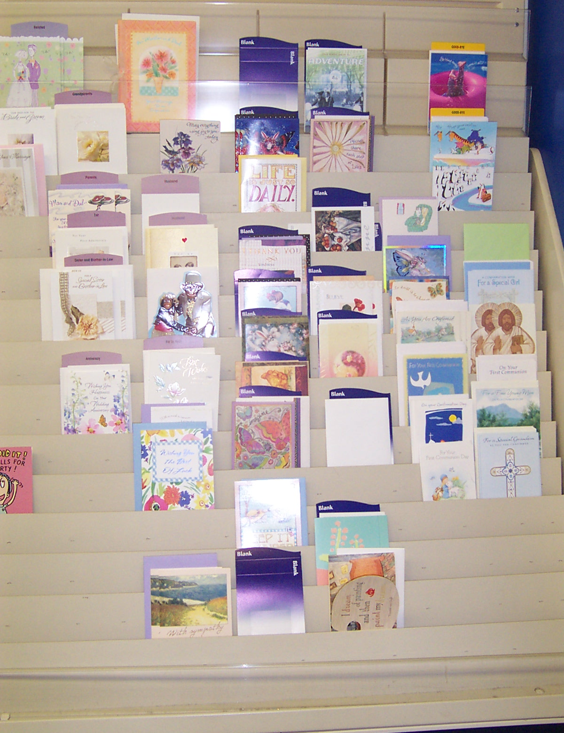
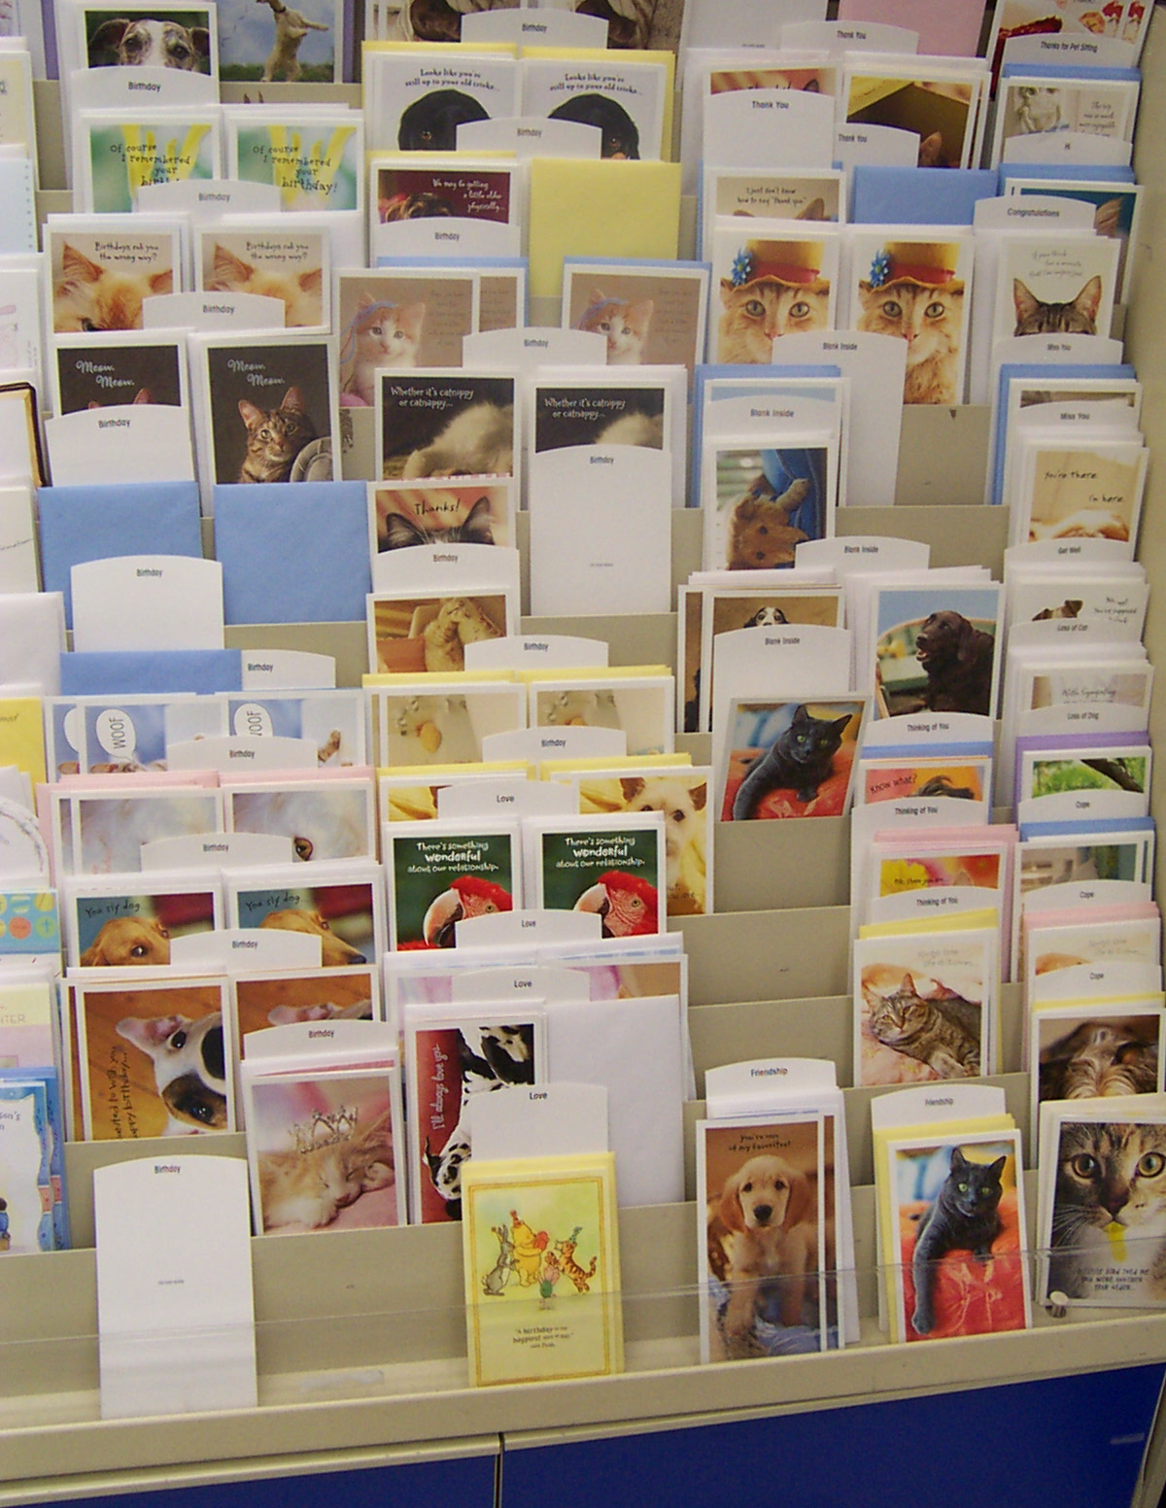
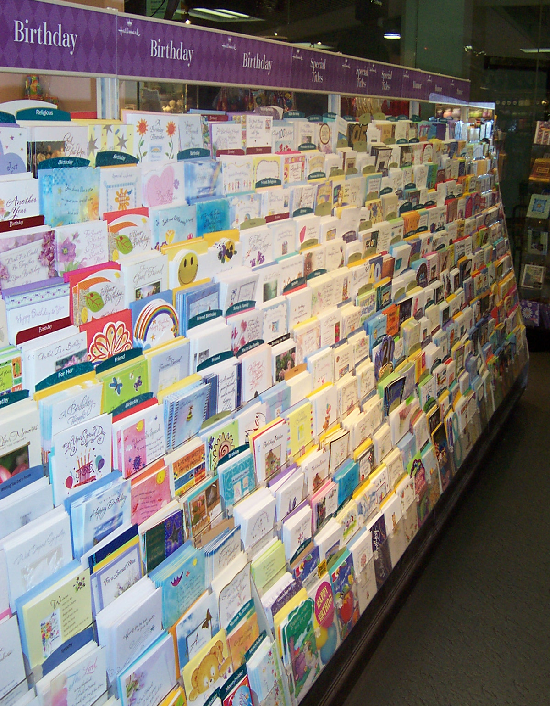
Two alternative strategies were considered to increase inventory turns for greeting cards
Strategy | Actions & Findings | Conclusion
1: Reduce Inventory | Excessive inventory was not the problem in stores Replenishment based on reorder points that are pre-set by Hallmark There is no sales data at the item-level for greeting cards, therefore it would be too risky for Katz to determine reorder points in place of Hallmark Katz has a linear square footage commitment to Hallmark and therefore cannot reduce frontage Inventory was extremely low in some stores Up to 25% empty spaces at 2 Rexall stores visited and numerous double facings (See A & B) Missing cards (i.e. birthday niece, nephew, engagement) Significantly less attractive than competitor next door (See C) | Not Desirable / Risky
A
B
C
LEGEND
A = Rexall at 700 University (24ft)
B = Rexall at Atrium on Bay (38ft)
C = Gateway competitor next to Rexall Atrium Store (Gateway is also supplied by Hallmark)
August 19th 2003

Slide 11
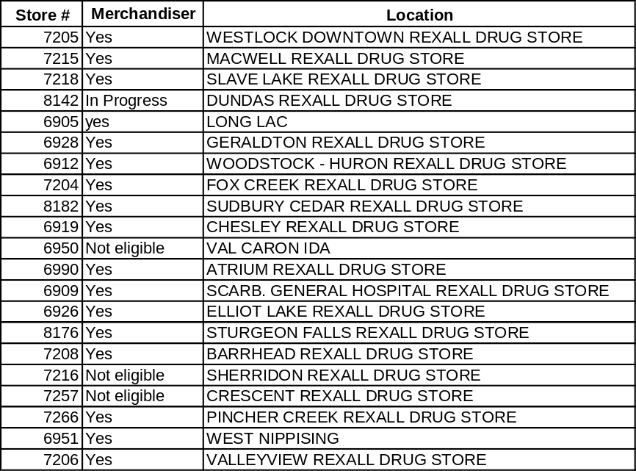
The most viable strategy was to stimulate sales by providing Retail Merchandising Services in 20 Rexall Stores by improving the appearance of the display and reducing stockouts
Strategy | Actions & Findings | Conclusion
2. Increase Sales | It was discovered that stores with low inventory also did not have Merchandise Services from Hallmark, despite the fact it is included as part of the Katz/Hallmark contract Because sales were significantly lower at stores with no Retail Merchandising Services, it is estimated sales could improve by $155,000 in one year by reducing stock-outs and improving the appearance of the card display in these stores | Low Difficulty High likelihood for success

Slide 12
The implementation of Retail Merchandising Services is estimated to improve sales by $155,000 per year
Benefits Assumptions
By getting Retail Merchandising Services in stores, average yearly sales should increase to the rate of stores with Retail Merchandising Services
  Similar store size
  Similar cards square footage
  Similar distribution of stores across urban and rural settings
Calculations
Average yearly sales for Rexall stores with retail merchandising services = $17,254
Average yearly sales for Rexall stores without retail merchandising services = $9,421
Yearly Increase in sales per store if merchandising services provided = $7,833
Sales impact for 17 stores until end of 2004 = $155,000

Slide 13
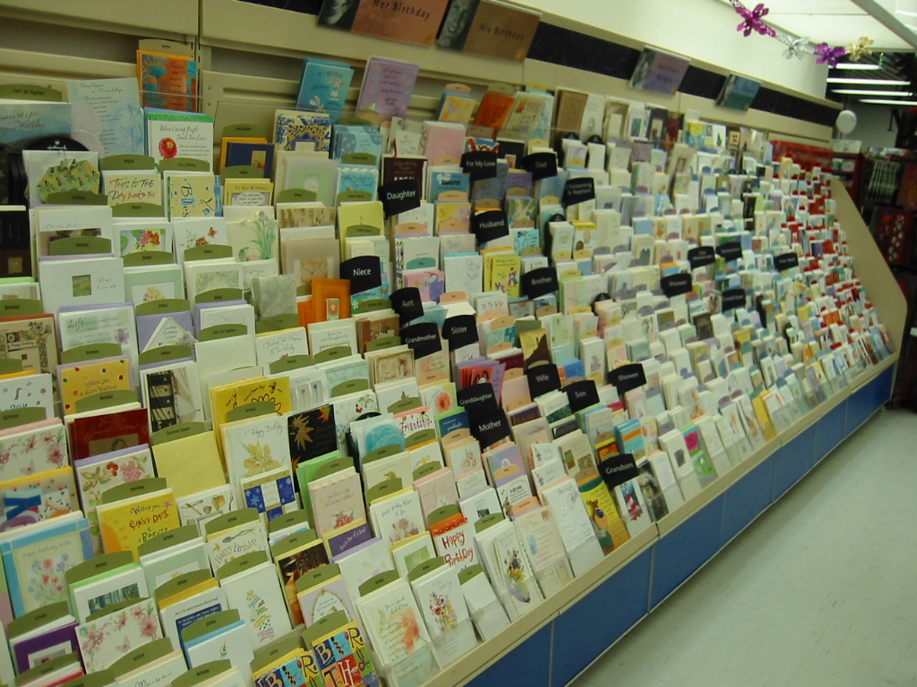
Merchandising Services have been implemented in 17 additional stores to date resulting in a significant improvement to the appearance of the display
After
“After” photo taken at the Rexall Store at Atrium on Bay on Dec 2, 2003

Slide 14
Quick Win #3
Determine the Accuracy of McKesson Invoices

Slide 15
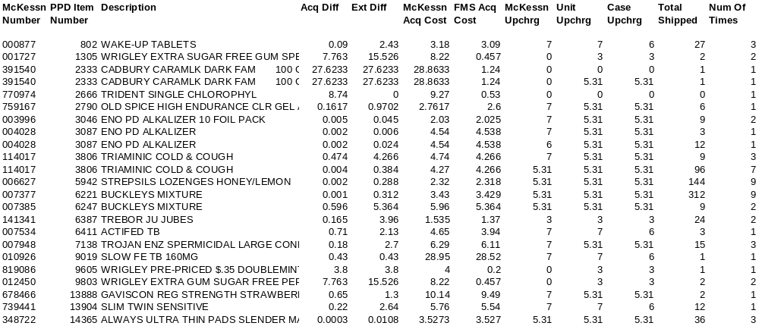
A program was developed to compare costs in FMS to invoice costs charged by McKesson
Includes a separate report for overcharges, undercharges and upcharge differences
30 fields (columns) in total (many not included in this sample) including separate cheque amount
Developed logic to identify cause of problem
  Report requires 4-8 hours of analysis to determine source of error
Program can be run at any time, for any subset of stores or invoices
Sample
Notes:
Initial comparison of McKesson invoices vs. Katz costs highlighted several issues
Case size not entered into FMS, reflecting a higher dollar difference (i.e. McKesson $12, Katz $1)
Inconsistent use of upcharges (sometimes added to list cost)
Costs out of date in FMS (i.e. list > promo, prebook cost entered into list cost and not updated etc)
Two things required for a true comparisons
Write a program that will check the correct cost in FMS, while accounting for promo vs. list and case size not in FMS
Clean up FMS costs
The program was completed and run in October 2003
Cost cleanup to be included in FMS Cleanup Program - to be complete by end of December

Slide 16
Results from a sample of stores revealed less than 1% McKesson overcharge errors. However, numerous FMS errors were identified
One weeks of McKesson invoices from 10 stores were compared against FMS Costs (7380 line items)
Estimated 100% of invoices had at least one error condition
50% of line items had an error condition (14% overcharge, 24% undercharge, 12% up charge difference)
Overcharge errors were attributed to a number of scenarios mostly caused by FMS error
  20% of errors were caused from case size errors in FMS
  6% of the errors were items invoiced with the separate cheque amount included in the list cost (Rexall items, Cover Girl, Jamieson)
  3% of the errors were items that had been delisted (no current cost)
  3% of the errors were items that had an expired contract
  5% of the errors were items that had contract pricing errors
  66% of the items were errors because the item was not eligible for a lower promotional cost
    store ordered less than a case
    items were ordered outside the promotional window

Slide 17
For the time being, the best use of this program is to help identify data errors in FMS so they can be resolved
Next Steps
  Enhance program so that it creates a user friendly reports that will pinpoint data errors without 4-8 hours of analysis
  Distribute report weekly to Category Managers (start date TBC)
  Assign responsibility to follow up with Category Managers to ensure they have cleansed their data
  Target roll-out is January/February 2004
  In addition, Category Managers and Assistants will be provided training on the components of cost by Rob Shaver. This will be included in training for FMS Lookup in late December or early January (TBC)
Benefits
  Target decline in invoice item errors by 40% in 4 months
  Katz will have a simple tool to identify data errors on an on-going basis after the FMS Cleanup program is complete

Slide 18
Quick Win #4
Clean Up FMS

Slide 19
An FMS Clean Up Program was developed to clean up data in FMS
Scope:
  Clean Up over 60,000 items in FMS
    Clean up all items in the wrong sub-category
    Clean up items assigned to the wrong Category Manager
    Clean up inconsistent brand names / vendor names / item names
    Clean up size and unit of measure and ensure they are in the correct field
    Clean up costs and retails that have expired contracts or are incorrect
    Clean up master pack and case size
    Identify and discontinue items with no sales in the past year
    Identify and discontinue items mapping to more than one PPD number
    Create action plan to markdown discontinued items, where applicable
    Create family groupings for items with in the same sub-category with the same size, UOM, cost and retail
    Assign a code to items (A = Plan-o-gram, C – Corporate item not in plan-o-gram/optional listing, I = In-out, S = Seasonal)

Slide 20
The FMS Cleanup Program is divided into three phases to complete the cleanup as quickly and efficiently as possible
STAGE 1
PRE-WORK
STAGE 2
CLEAN-UP
STAGE 3
IMPLEMENT
Identify items with no sales
Clean MSQ, Case Pk
We are Here
Clean up description, size, sub-cat, vendor, families
Casper Team
Review changes, clean costs & retails, markdown items
D. MacKinnon, J. Goodridge Category Managers
Refresh
POS
SEPTEMBER OCTOBER NOVEMBER DECEMBER JANUARY

Slide 21
The benefits of clean data in FMS are spread across multiple processes and areas of the business
Benefits
Reduces the number of items to be maintained
  So far 15,000 Herbies items have been discontinued where there have been no sales in the last year
  Estimated an additional 50-60% of active items in FMS will be discontinued by January 2004
    Majority of these items are from the Herbies Conversion. Many are old item with low sales
Creates one item master file and eliminates independent databases/spreadsheets for good
Increases speed to create promotions for family of items
Allows faster, more efficient searches for items
Clean data will allow us to hold Vendors (McKesson) accountable for costs
Markdowns will help move discontinued inventory out of stores
Accurate costs and retails in FMS, POS and subsequently Microstrategy
Data integrity is first step towards managing our Supply Chain

Slide 22
Although it is difficult to quantify, the benefit of clean data can also be viewed as having a $$ value to Katz
Save costs associated with correcting invoice errors
Each invoice error costs $40 - $400 to fix according to an A.T. Kearney study
By cleaning data in FMS, this will reduce the overall number of invoice errors on-going
Reduce on-going costs associated with correcting the FMS Item Master
Errors in the item master costs $60 - $80/item to correct according to a study by the Grocery Manufacturing Association (GMA)
There are approximately 60,000 items in FMS and an estimated 60% of items have errors in item master file
After cleanup program is completed and tools and processes are implemented to help maintain clean data, Katz should be able to maintain 30% or fewer errors
Another way to look at it….
According to A.T Kearney analyst, Wegman’s Food Markets is savings of 1% of sales after cleaning up its item master file*. If Katz achieve 10% of the benefit that Wegmans achieved after it’s cleanup, this would result in savings of 0.01% of Katz sales. This would equal $1.6M savings in sales
* Data Integrity: Wal-Mart’s Dirty Secret, Forbes.co, 10/07/02

Slide 23
Quick Win #5
FMS Lookup

Slide 24
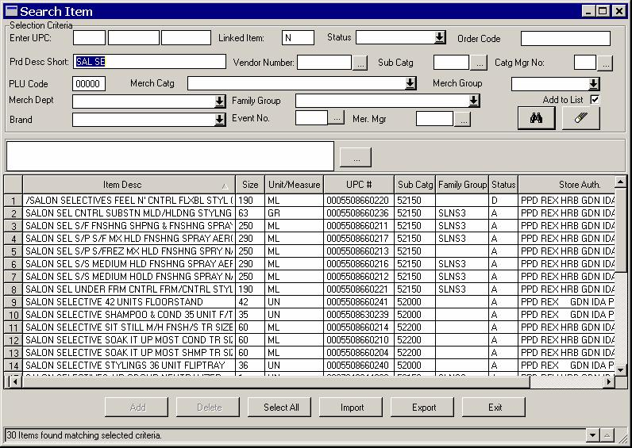
FMS Lookup is a new tool that allows Category Managers to view and modify item info, including cost and retail, in real time
The first release implementation of FMS Lookup was completed and rolled out to users in September 2003
  Provides easy ability to look up items in FMS
The second release implementation will be completed and rolled out in December 2003
  Provides easy ability to change cost, retail and other item info directly in FMS

Slide 25
FMS Lookup will eliminate the need for Category Managers to maintain their own databases, among many other benefits
Benefits
Ensures data in FMS is up-to-date and accurate
Fast and easy access to data
Eliminates duplicate data-entry of all cost and retail changes normally completed by Merchandise Services
Frees knowledgeable staff for other roles and responsibilities

Slide 26
Quick Win #6
Pricing Methods

Slide 27
Three new pricing methods were developed and implemented in September 2003 to enable new promotional functionality
“Buy one, Get one free” (or at a reduced value), without the need for a coupon
The ability to “Buy Up” (purchase multiple quantities) to get a greater bargain
“Limited Quantity” option
Benefits
  New functions will allow more competitive promotional advertising, which will drive the pricing value statement
  New capabilities will make the transactions at the point of sale easier to complete by leveraging system capabilities
  Addition margin impact from updating buy one, get one to charge higher price for single item (for example: buy 2 at $0.99, but one at $0.49 in old method. Using new method, buy one at $0.59 in new method, therefore $0.10 improvement in margin)

Slide 28
Quick Win #7
Electronic Pricebook

Slide 29
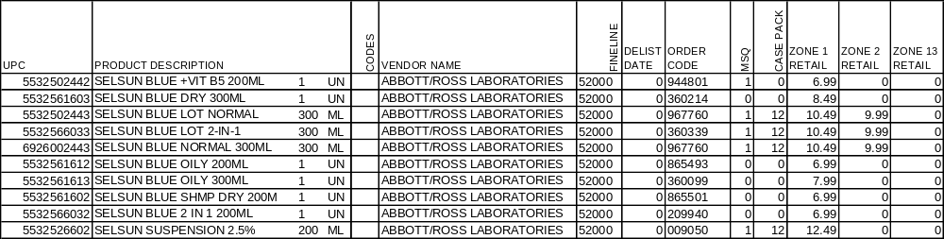
A price book for each banner is being created and will be distributed to Regional Managers in December
Separated into three sections:
  New Items – sorted by add date
  Delisted Items – sorted by delist date
  All other active items – sorted by fineline, vendor name and product description
Searchable, printable adobe file that cannot be edited (minimal training required)
Distributed monthly via email (file = ~4.5 MB)
IT will be involved to ensure files are sent during a low-traffic period
Initial distribution is to Regional Managers for HBC category. Stores may be added upon request
Benefits:
Gives store managers easy access to look up retails
Provides new stores with as starting point for creating assortments

Slide 30
Overall, there has been significant progress made against the 7 Quick Wins projects
Quick Wins Projects | Status
#1: Reduce Discontinued Inventory | Complete (implementation transitioned to Operations)
#2: Improve DSD Inventory Turns (Cards) | Complete
#3: Determine Accuracy of McKesson Invoices | Initial scope completed User friendly reports to be completed in early 2004
#4: Cleanup FMS | Phase I completed. Overall cleanup to be completed in January 2004
#5: FMS Lookup | Phase I completed. Phase II to be implemented in December 2003
#6: Pricing Methods | Complete
#7 Electronic Price Books | On-Going
IBM will remain involved in the Quick Wins until mid-January 2004. This report will be updated and resubmitted at that time.

